Slide 1

Using Fiction to help students understand difference, disability, and “Specialness”
Stephanie Lewis Thompson
Composition Department
Notes:
NOTE:
To change the image on this slide, select the picture and delete it. Then click the Pictures icon in the placeholder to insert your own image.

Slide 2
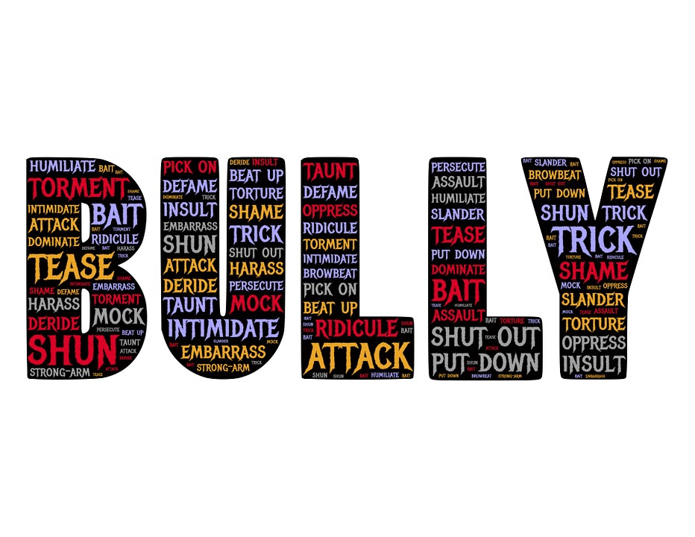
The problem. . .
Children with autism are 3 times more likely to be bullied than peers
Children with epilepsy and medical conditions like cerebral palsy are more likely to be bullied and called names than their peers
Kids who are bullied are more likely to suffer from depression, anxiety, sleep issues, health problems, and lower GPAs and test scores. (StopBullying.gov, n.d.)
CC0 Creative Commons

Slide 3

The solution
The K8 School District should require middle school English classes to read a book dealing with disability because the conversations these books raise help to reduce bullying and encourage inclusion.
CC0 Creative Commons

Slide 4
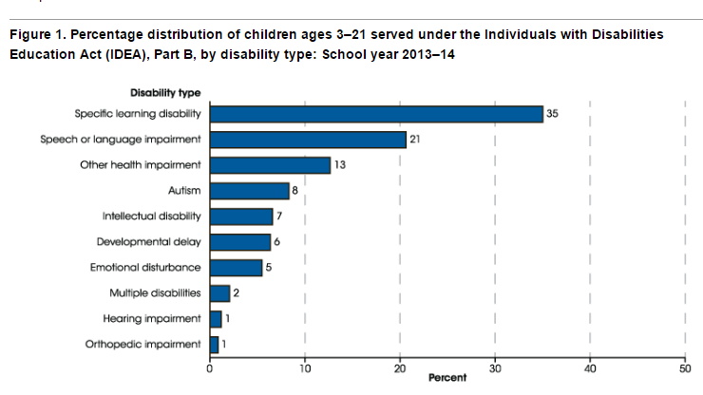
By the 2013-2014 school year, 6.5
million students (13%) were receiving
special needs services, and 90%
of those students spend some time
in a general education classroom
(NCES, 2016)
(NCES, 2016)

Slide 5

Children with autism are 3 times more likely to be bullied than peers
Children with epilepsy and medical conditions like cerebral palsy are more likely to be bullied and called names than their peers (Stopbullying.gov, n.d.)
Bullying
Statistics
Kids who are bullied are more likely to suffer from depression, anxiety, sleep issues, health problems, and lower GPAs and test scores. (StopBullying.gov, n.d.)

Slide 6

Rules (Cynthia Lord, 2006)
Lord’s daughter asked her “Mom, how come I never see families like mine in books and on TV”? Rules is meant to change that.
Narrator Catherine is the older sister to David, who is on the autism spectrum.
She creates rules, like “no toys in the fish tank” and “keep your pants on in public” to help her brother navigate social situations (and reduce embarrassment to her!)
(Albertson, 2006)

Slide 7

Rules (Cynthia Lord, 2006)
Includes a reader’s guide geared towards middle school students.
Have students create a list of rules they would like peers to follow and discuss their motivations for those rules.
CC0 Creative Commons

Slide 8
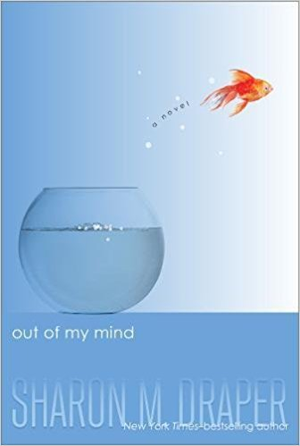
Out of my Mind (Sharon Draper, 2010)
Comes from the perspective of narrator Melody, an 11 year old with photographic memory, a love for words, and an inability to speak thanks to her cerebral palsy.
A doctor tells Melody’s mother that she is “severely brain-damaged and mentally retarded” (p. 22).
Explores how a communication device helps Melody communicate with others and display her intelligence.
Examines the social, physical, and emotional challenges that a special needs child faces but reminds us that we can never know everything in a child’s mind.
(Sfetsios-Conover & Chang, 2010)

Slide 9

Wonder (R. J. Palacio, 2012)
Auggie’s difference is physical—he has Treacher Collins Syndrome, which only occurs in 1 out of every 10,000 births (Children’s Craniofacial Association, 2005)
Includes chapters from Auggie’s perspective as well as his friends and the boy, Julian, who bullies him that was added to later editions of the novel.
(Carpenter, 2012)

Slide 10
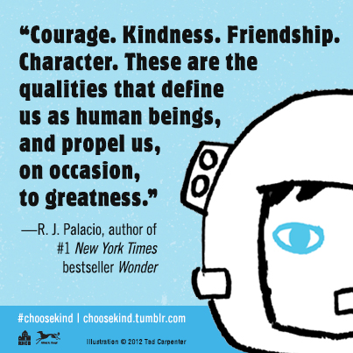
Choose Kind
For more on the “Choose Kind” pledge that classrooms can take, see http://choosekind.tumblr.com/resources.
The site includes teaching resources, the “Daily Wonder” app with inspirational daily sayings, and more information about the Children’s Craniofacial Association and bullying prevention.
(ChooseKind Tumblr, 2018)

Slide 11

I am Auggie Pullman (video)
(CCA Kids, 2017)

Slide 12
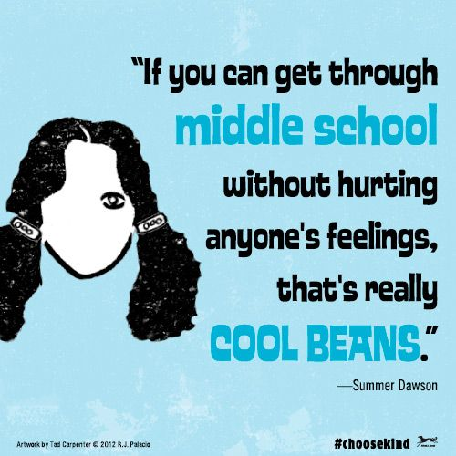
A plea
Bullying is a wide spread problem that needs a community solution. Because children with disabilities are bullied at a higher rate, parents and educators have to be creative in helping other children understand differences. While not all books will work in all settings, a wealth of books like Wonder provide a starting point for educators, parents, and students to start the conversation.
(ChooseKind Tumblr, 2018)

Slide 13
Other suggestions
Fiction
Nonfiction
The Curious Incident of the Dog in the Nighttime (Mark Haddon, 2003)
The Goldfish Boy (Lisa Thompson, 2017)
Short (Molly Goldberg Sloan, 2017)
Al Capone Does My Shirts (Gennifer Choldenko, 2006)
A Corner of the Universe (Ann M. Martin, 2007)
The Luster of Lost Things (Sophie Chen Keller, 2017)
Mockingbird (Kathryn Erksine, 2011)
Views from Our Shoes: Growing up with a Brother or Sister with Autism (Ed. Donald J. Meyer, 1997)
Look Me in the Eye: My Life with Asperger’s (John Elder Robison, 2008)
Life, Animated (Ron Suskind, 2014)
The Reason I Jump (Naoki Higashida, 2013, introduction by David Mitchell)
Temple Grandin: How the Girl Who Loved Cows Embraced Autism and Changed the World (Sy Montgomery & Temple Grandin, 2012)

Slide 14
References
CCA Kids. (2017, June 4). I am Auggie Pullman [Video file]. Retrieved from https://www.youtube.com/watch?v=Q73kk-GIAOY
Children’s Craniofacial Association. (2005). A guide to understanding Treacher Collins Syndrome. Retrieved from http://www.ccakids.org/assets/syndromebk_treacher-collins.pdf
National Center for Education Statistics (NCES). (2016, May). Children and youth with disabilities. Retrieved from http://nces.ed.gov/programs/coe/indicator_cgg.asp
Stopbullying.gov. (n.d.). Bullying and children and youth with disabilities and special health needs. Retrieved from https://www.stopbullying.gov/at-risk/groups/special-needs/bullyingtipsheet.pdf and https://www.stopbullying.gov/at-risk/groups/special-needs/

Slide 15
References: Novels, Cover Art, and Images
Albertson, K. (2006). Rules cover art [Image]. New York: Scholastic Corporation.
Carpenter, T. (2012). Wonder cover art [Image]. New York: Simon & Schuster.
Choose Kind Tumblr. (2018). Quote from R. J. Palacio. [Image file]. Retrieved from http://choosekind.tumblr.com/
Draper, S. (2010). Out of my mind. New York: Simon & Schuster.
Lord, C. (2006). Rules. New York: Scholastic Corporation.
Palacio, R. J. (2012). Wonder. New York: Alfred A. Knopf.
Sfetsios-Conover, D. & Chang, D. (2010). Out of my mind cover art [Image]. New York: Simon & Schuster.

